Slide 1
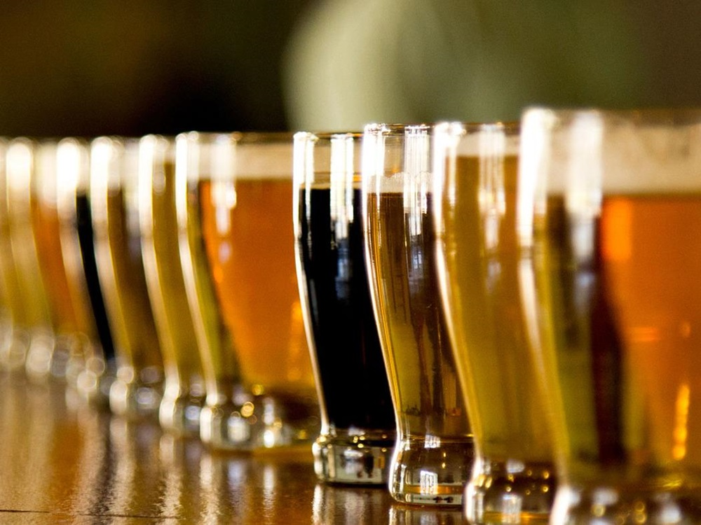
Beer Analytics
Hops and Dreams
Sabrina Purvis
Senthil Kumar
Akbar Thobani
Presenter:

Slide 2

Agenda
Evaluating the competition
USA State by State comparison of competing breweries
ABV Analysis
IBU Analysis
Decision Making
Notes:
Summarize and change the format to Anz format

Slide 3
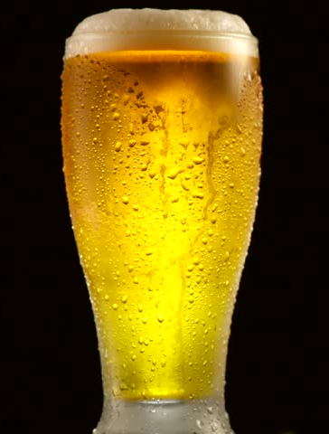
Agenda
Evaluating the competition
USA State by State comparison of competing breweries
ABV Analysis
IBU Analysis
Decision Making
Notes:
Summarize and change the format to Anz format

Slide 4

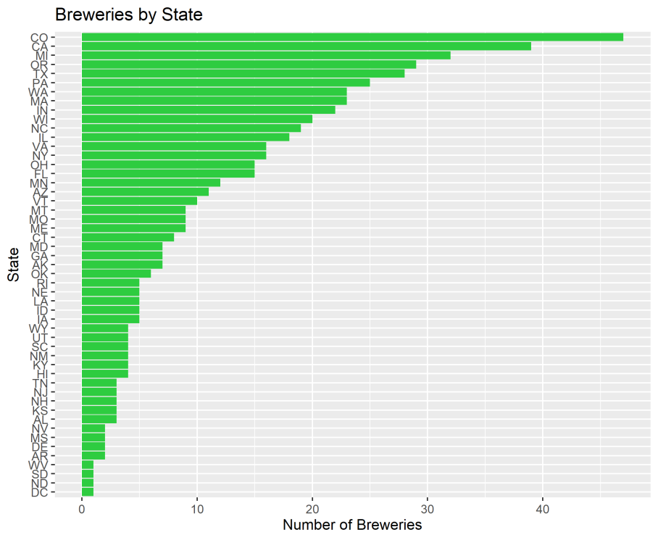
Evaluating the competition
Note the concentration of breweries on the Pacific Coast & in the North East

Slide 5
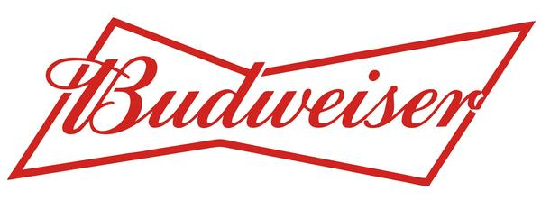
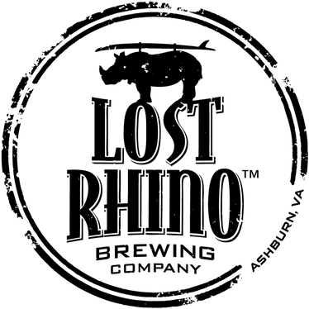
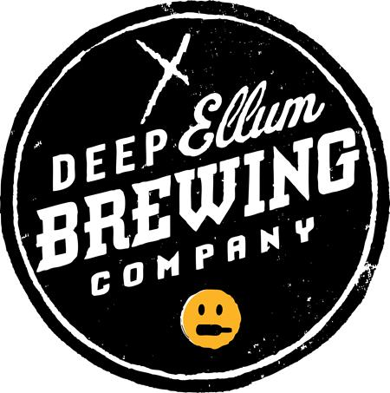
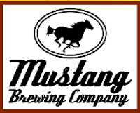

Missing Values in the Dataset
The original beer dataset had 2410 listed beers.
Upon further inspection, the team recognized that the data had duplicate information. Identically named beers with only a beer ID variation were included it the original dataset. The team removed any instance where only the beer ID in the related observations was different.
We then discovered that the same beer also existed in multiple Ounce designations. Because we knew that we were evaluating ABV, IBU and their correlation, we removed any beer listed more than once to remove that bias in the dataset.
Finally, we had missing values in ABV and IBU. We simply removed those observations as well since we understood that we needed both variables for each observation to make the comparison.
Our final dataset consisted of 1341 observations

Slide 6
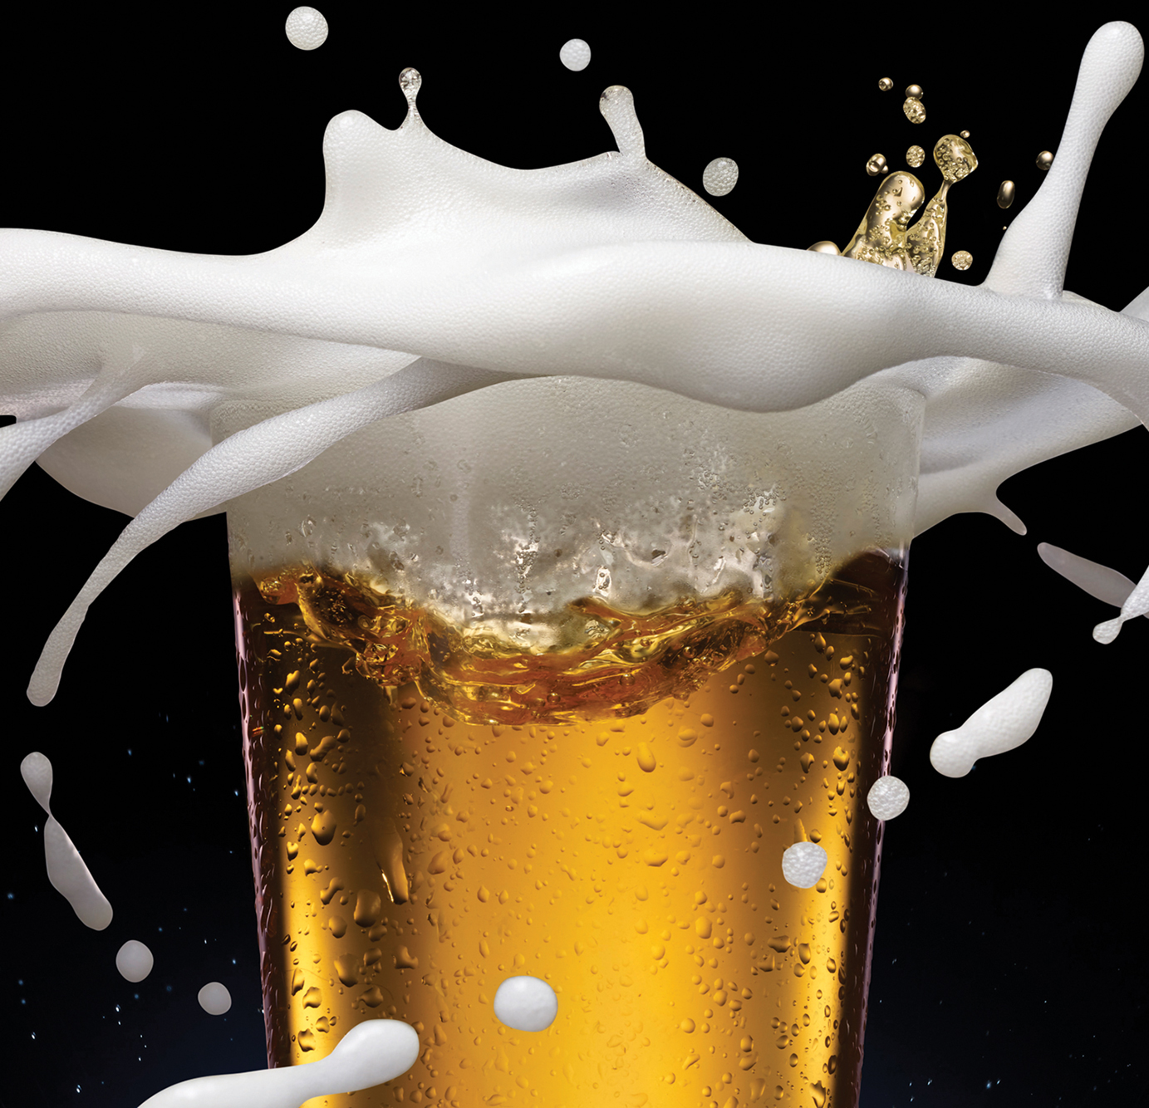
Data Review
Original dataset of 2410 beers
With 551 Breweries
In 51 States

Slide 7
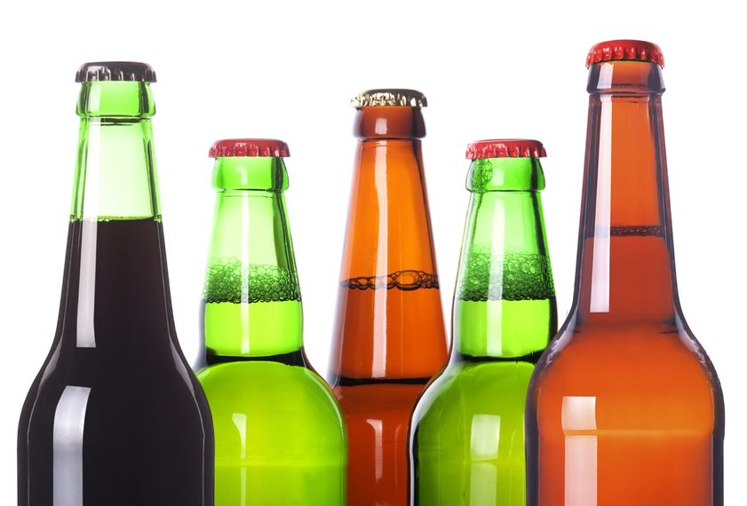
Data Cleanup
Total missing ABV values – 1005(42%)
Total missing IBU values – 62(3%)
Duplicates – 78(3%)
Notes:
The original beer dataset had 2410 listed beers.
Upon further inspection, the team recognized that the data had duplicate information. Identically named beers with only a beer ID variation were included it the original dataset. The team removed any instance where only the beer ID in the related observations was different.
We then discovered that the same beer also existed in multiple Ounce designations. Because we knew that we were evaluating ABV, IBU and their correlation, we removed any beer listed more than once to remove that bias in the dataset.
Finally, we had missing values in ABV and IBU. We simply removed those observations as well since we understood that we needed both variables for each observation to make the comparison.
Our final dataset consisted of 1341 observations

Slide 8
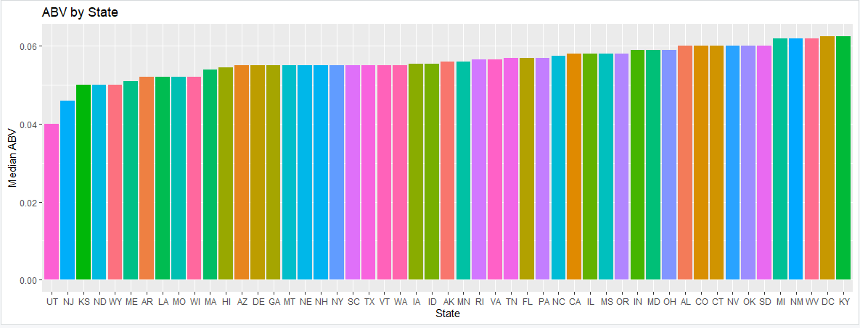
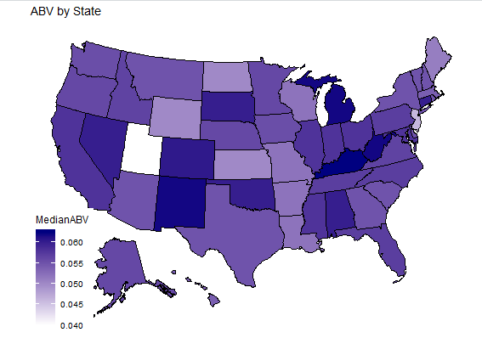
Understanding the trend of Alcohol by Volume
Median alcohol by volume is fairly consistent between 5% & 6.3%, unless you are in Utah or New Jersey
The highest single ABV hails from Boulder, Colorado at 12.8% ABV

Slide 9
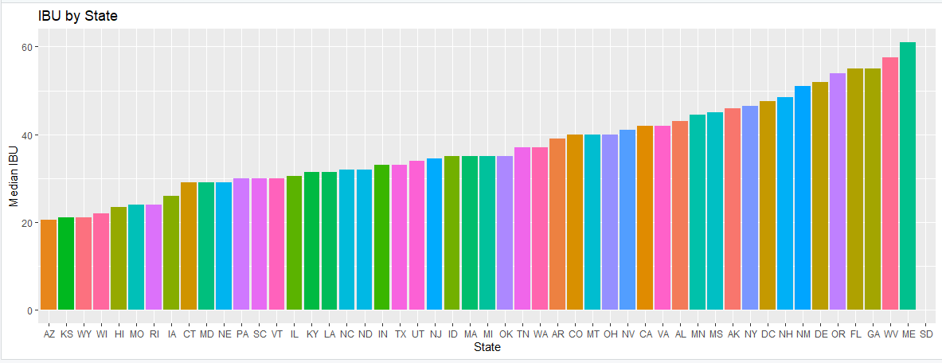
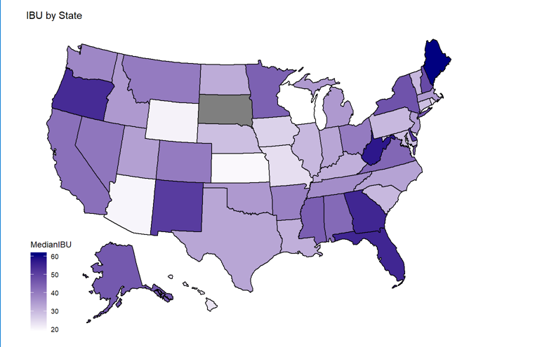
Understanding the Trend of International Bitterness Units
Median IBU is much more disparate
Median value ranges from just under 20 to just over 60
The most bitter beer comes out of Astoria, Oregon at an IBU score of 138

Slide 10
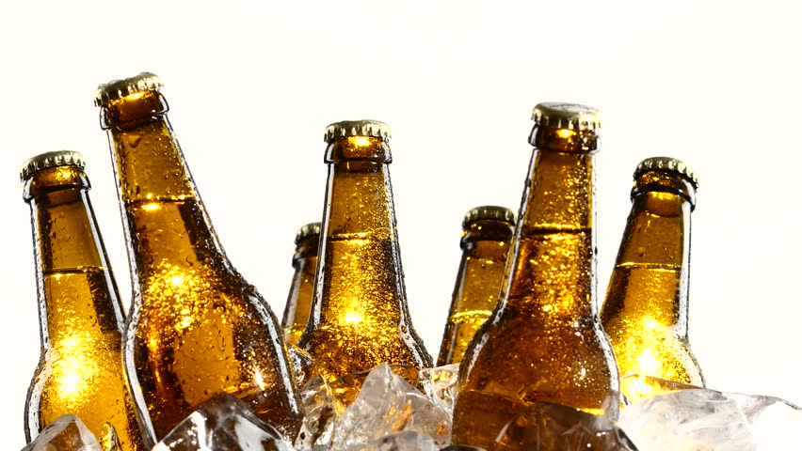
Max ABV & IBU by State
State with Max ABV Beer – CO (12.8%)
Lee Hill Series Vol. 5 Belgian Style Quadrupel Ale
State with Min ABV Beer – CA (0.1%)
Scotty K NA
State with Max IBU Beer – OR (138)
Bitter Bitch Imperial IPA
State with Min IBU Beer – CA (4)
Summer Solstice

Slide 11
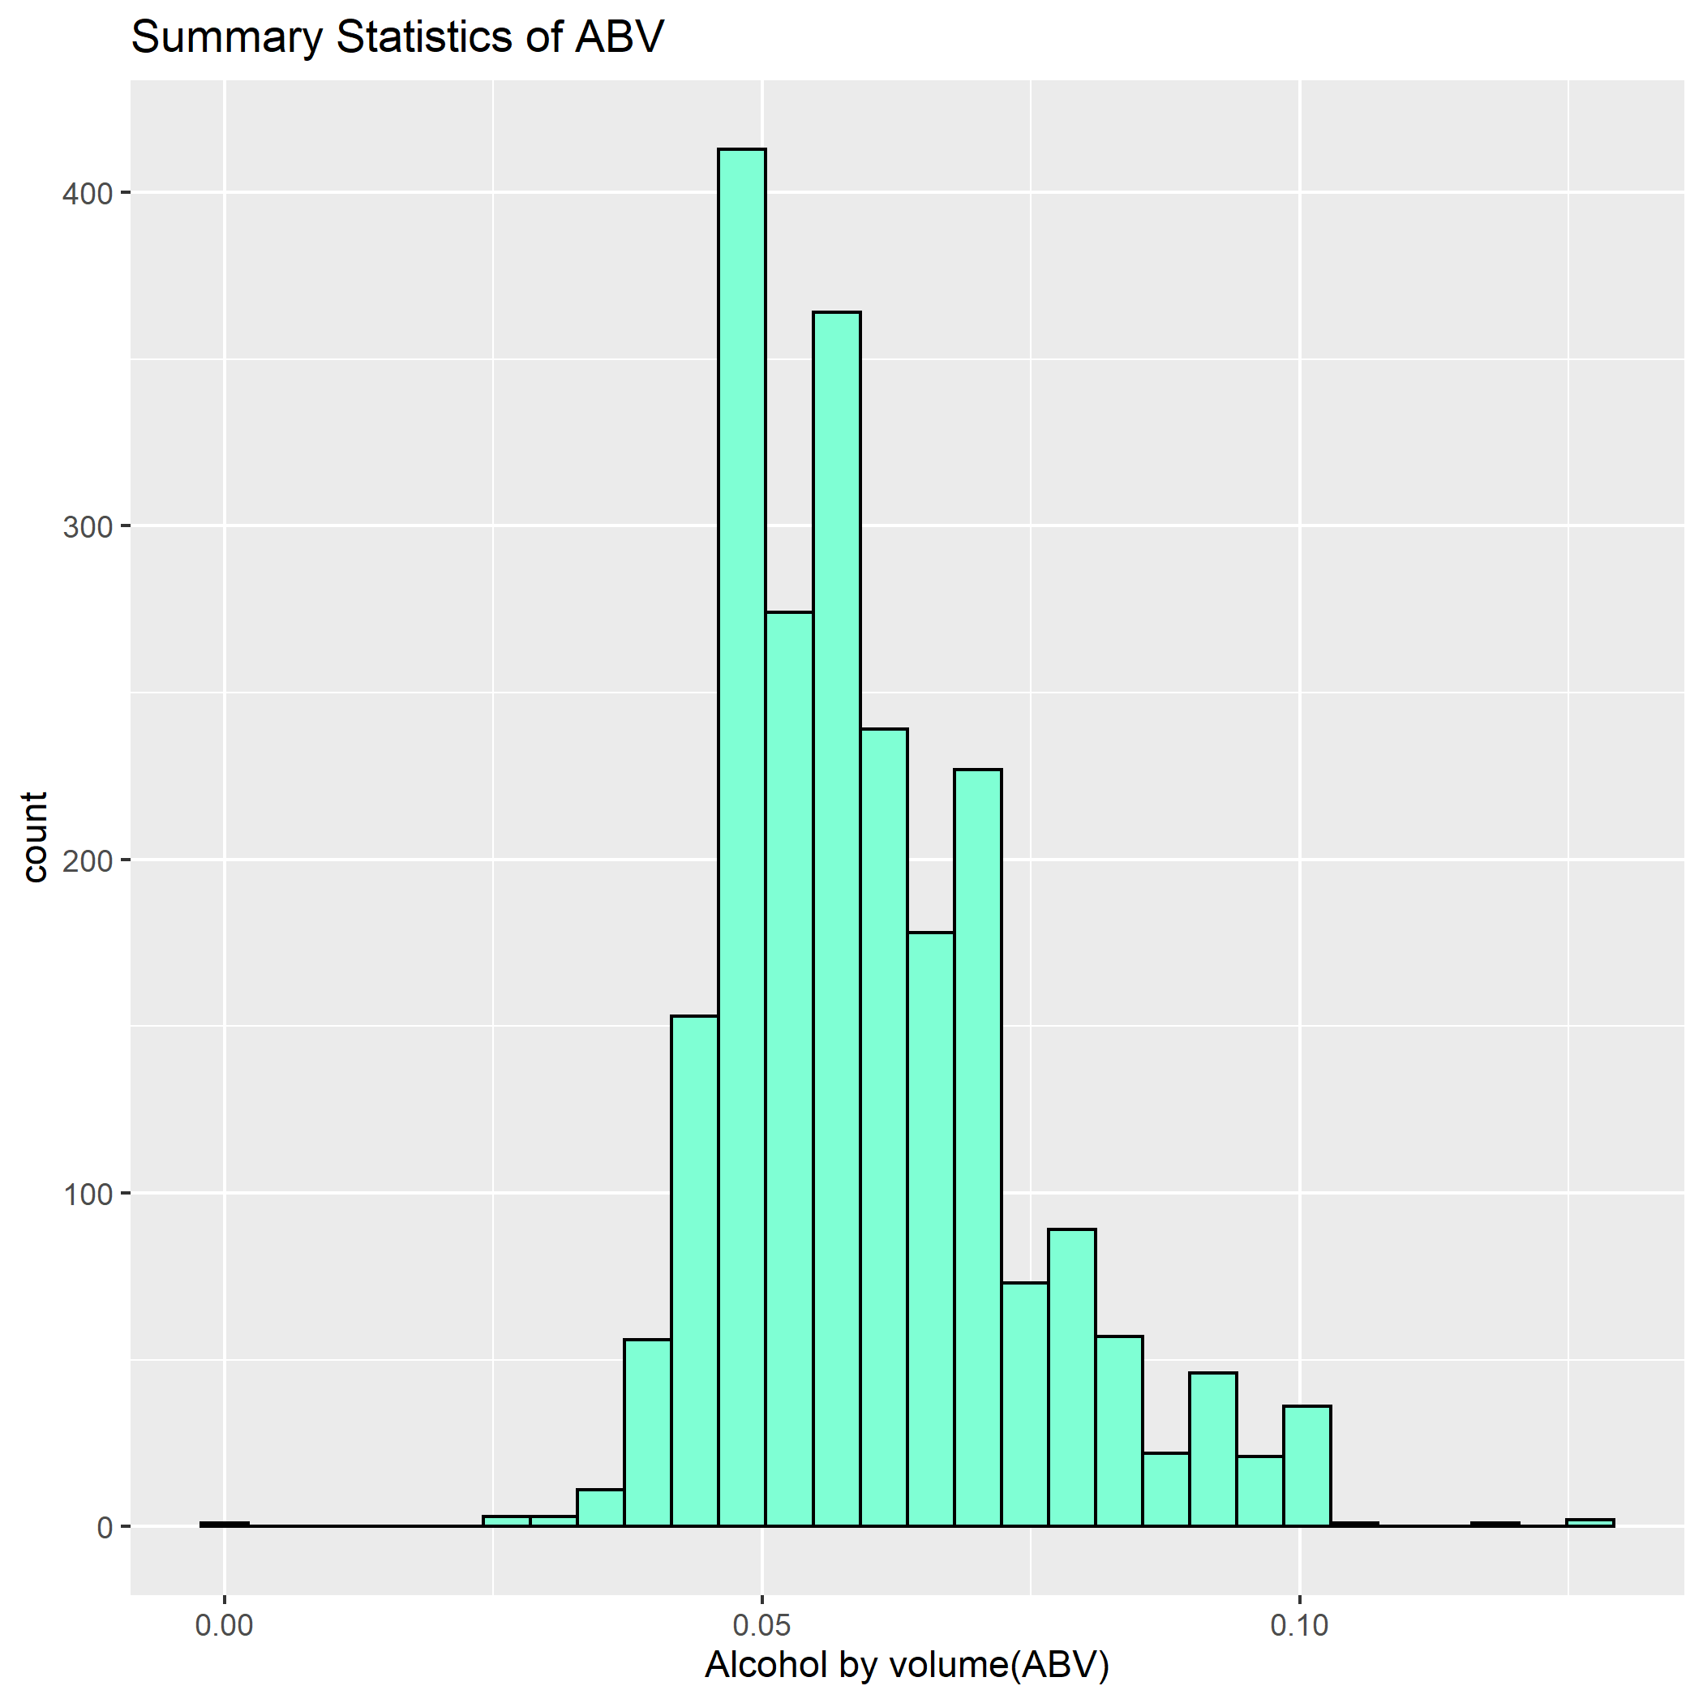
Analyzing Summary statistics and distribution of ABV variable
Min. 1st Qu. Median Mean 3rd Qu. Max. NA's
0.00100 0.05000 0.05700 0.05993 0.06800 0.12800 62
From the summary statistics, it can be inferred that the ABV of our craft beers dataset follows a normal distribution because the median and the mean values are very close.
There is a slight right skew to the data. Also from the Median One thing to note is that 75% of all the beers have a 5% ABV or more. However, the interquartile distance is only 1.8% suggesting that 50% of the data is bounded between 5% and 6.8% ABV.
It is also important to remember that missing values are not included in the summary statistics, and there's a possibility that this representation may not be accurate.

Slide 12
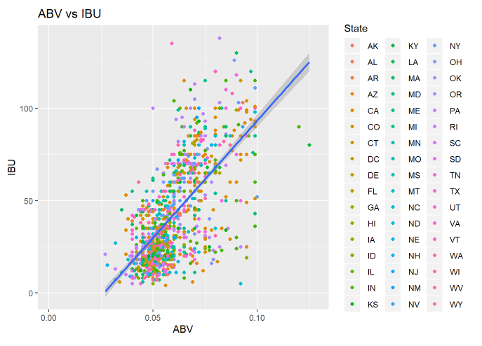
Further Dive into ABV and its influence
The scatterplot provides visual evidence for a moderate positive linear relationship between the alcohol content and the IBU values (R-Squared 0.6655), meaning that 66.55% of the variation in the IBU of craft beers is explained by the Alcohol By Volume variable .
This means that there are numerous other factors that may affect the IBU but are not accounted for in this linear regression. A simple way to define this relationship is that for every 10 point increase in the IBU value, there is an increase of .34% units in the ABV value (pvalue < 0.001).
Also to keep in mind for this regression analysis that 40% of the IBU data is missing. This could be strongly influencing the regression coefficients.

Slide 13
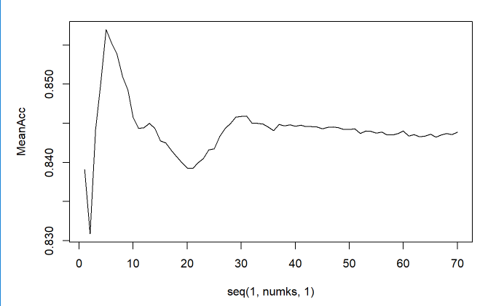
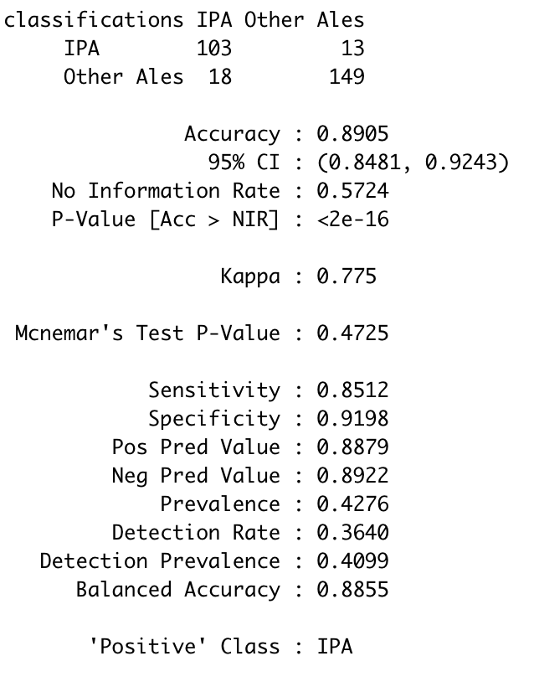
Understanding the types of beers
Relationally, IBU and ABV matter to each other when determining the type of beer you plan to produce (IPA vs standard Ales)
Analysis using KNN classification model provided 89% accuracy, it also suggest ~K=5 provides best Mean Accuracy

Slide 14
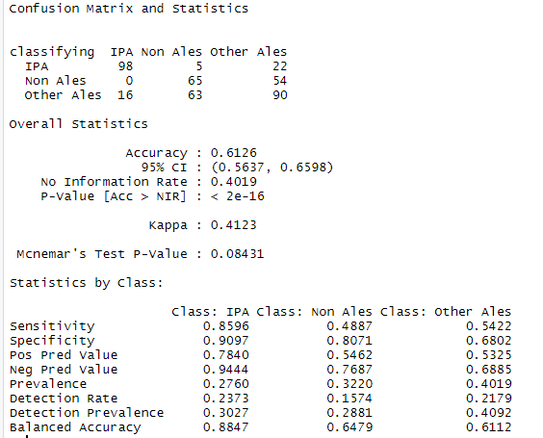
Digging Deeper – does type matter?
Looking at our classification, type definitely plays – if you are an IPA. IPA’s are strongly predictable based on ABV and IBU.
They are a distinct type of beer
Conclusion
From the case study we could say there’s moderate positive correlation between bitterness and alcohol content of beer.
It suggests there are other factors that’s not accounted for in this case study to be influencing this factor. It would be interesting to know what other factors that’s involved in the brewing process and if those data can be brought in to see if there’s any change in this relationship.
Also further study could be made by filling in the missing IBU data to see what influence this data might produce in this relationship.

Slide 15
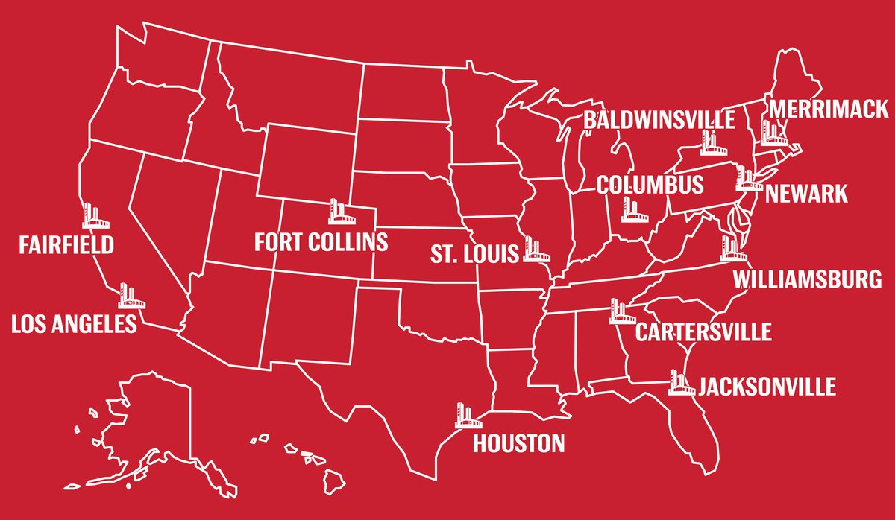
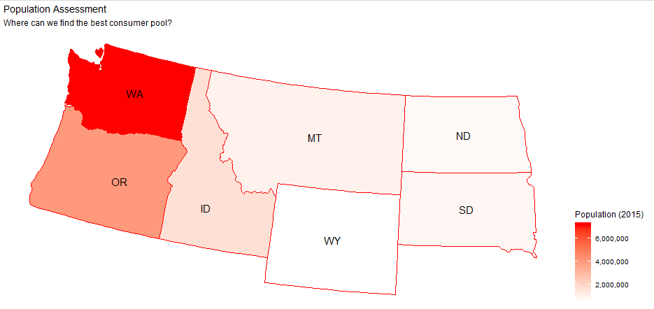
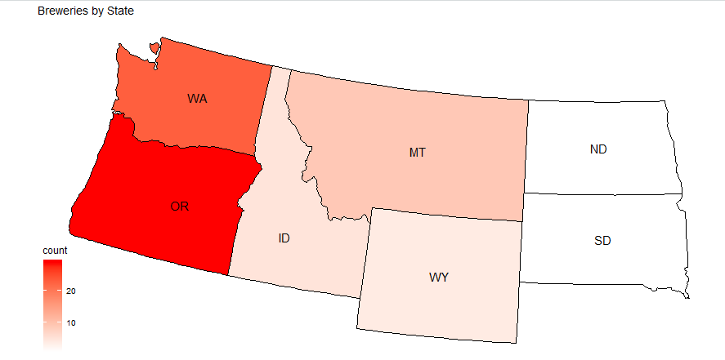
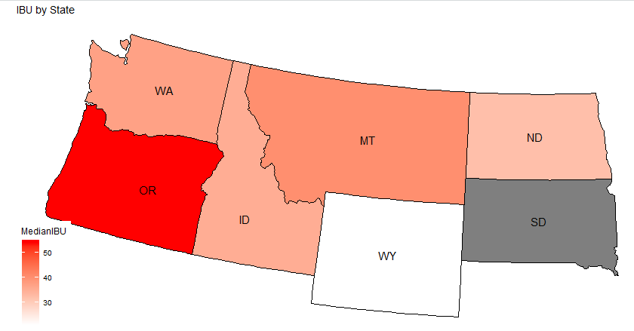
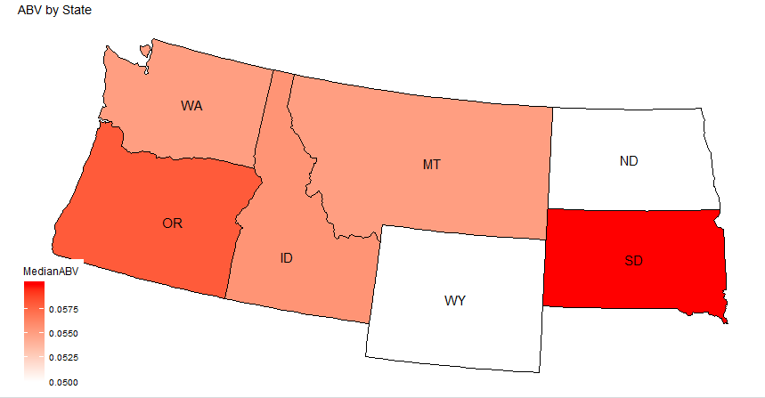
Expansion Plans
Budweiser Brewery Locations
Budweiser currently has 12 breweries in the US - where is the next logical place to build a brewery?
Washington
23 Breweries
5.5% Median ABV
37.0 Median IBU
Budweiser comparables
5.0% ABV
7.0 IBU
To be successful in Washington, you need to consider developing a brew with a higher IBU

Slide 16
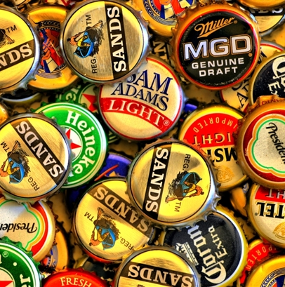
Thank You

